Slide 1

Atlantis
Erla Sturludóttir
erlasturl@gmail.com
UNU-FTP
Iceland

Slide 2
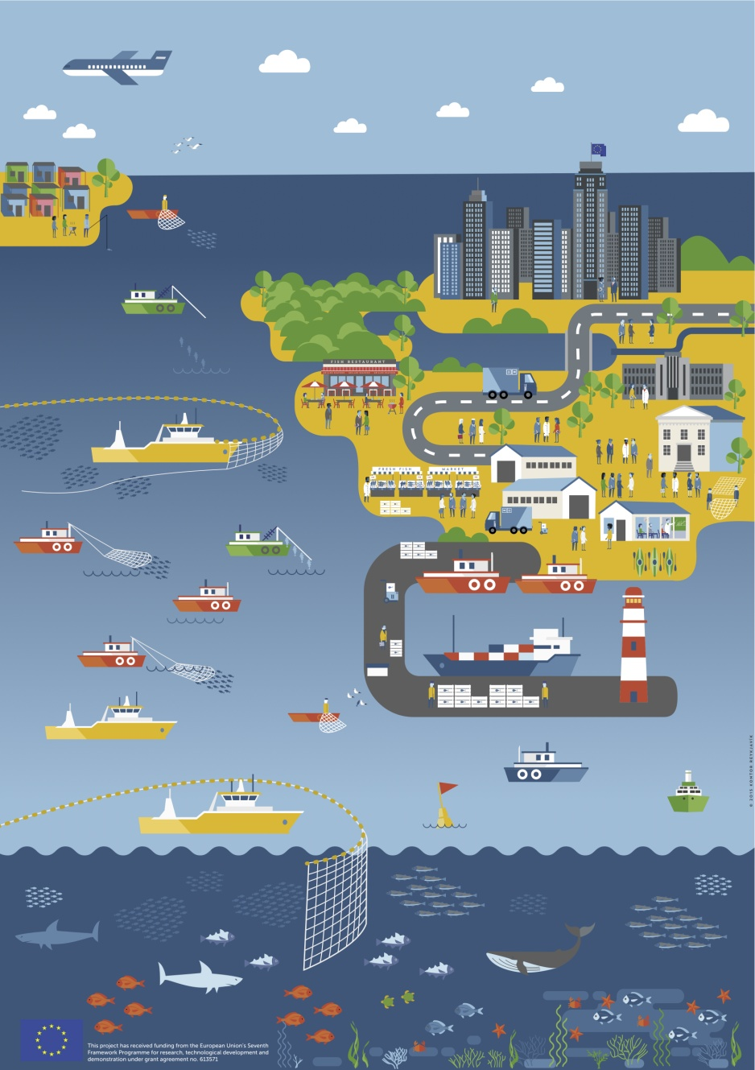
Atlantis
Simulates the entire ecosystem.
Ecosystem model
Fisheries model
Sampling and assessment model
Management model
Socio-economic model

Slide 3
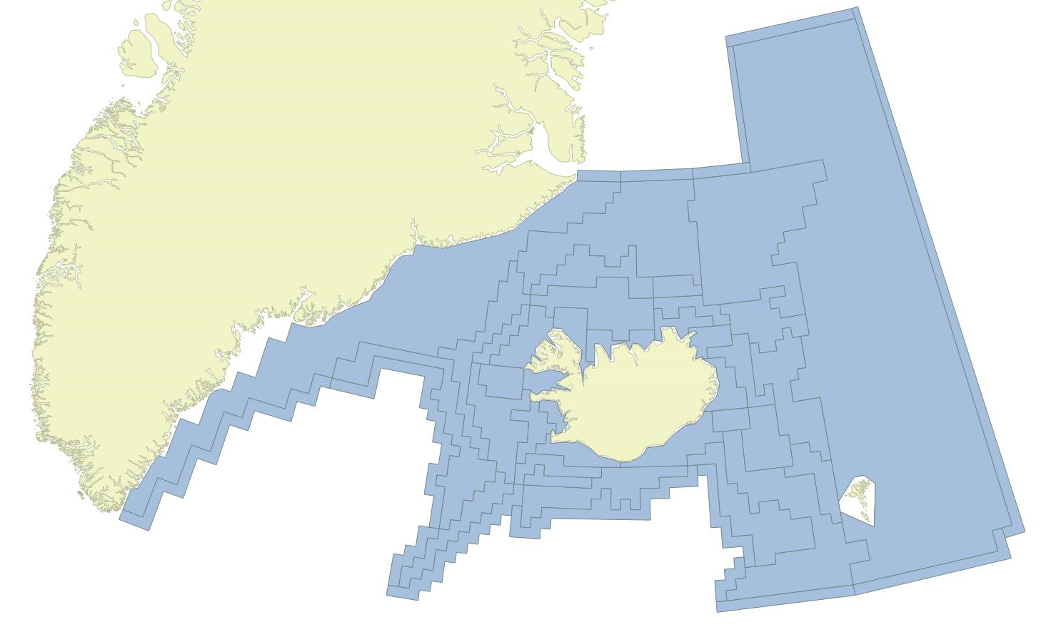
The Icelandic Atlantis model
 | 50 m
 | 150 m
 | 300 m
 | 600 m
 | 1000 m
 | 1000+ m
 | Sediment
1,600,000 km²
53 boxes
36 active
15 boundary
2 land
7 layers
6 water column
1 sediment

Slide 4
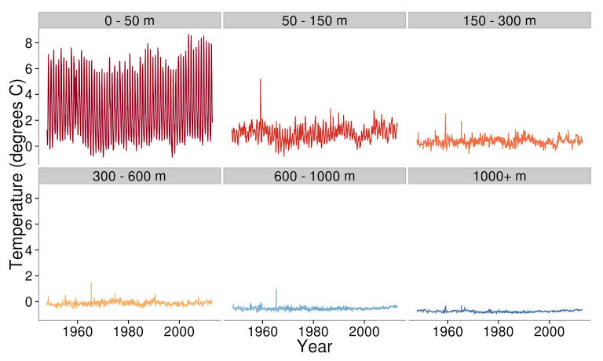
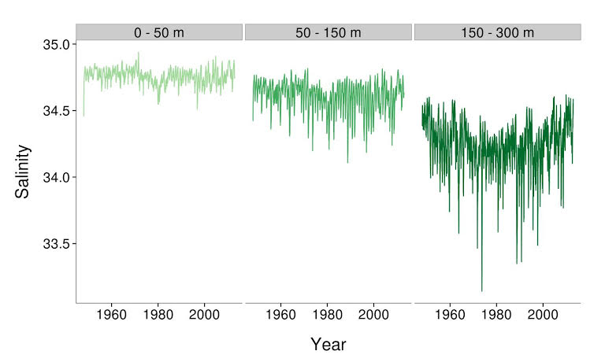
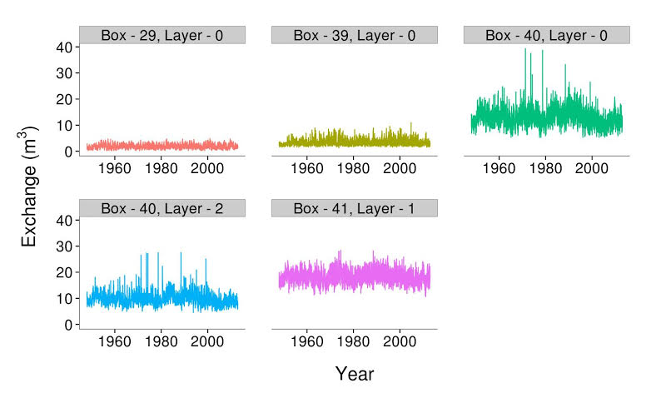
The oceanography model
Water fluxes from Layer 1

Slide 5
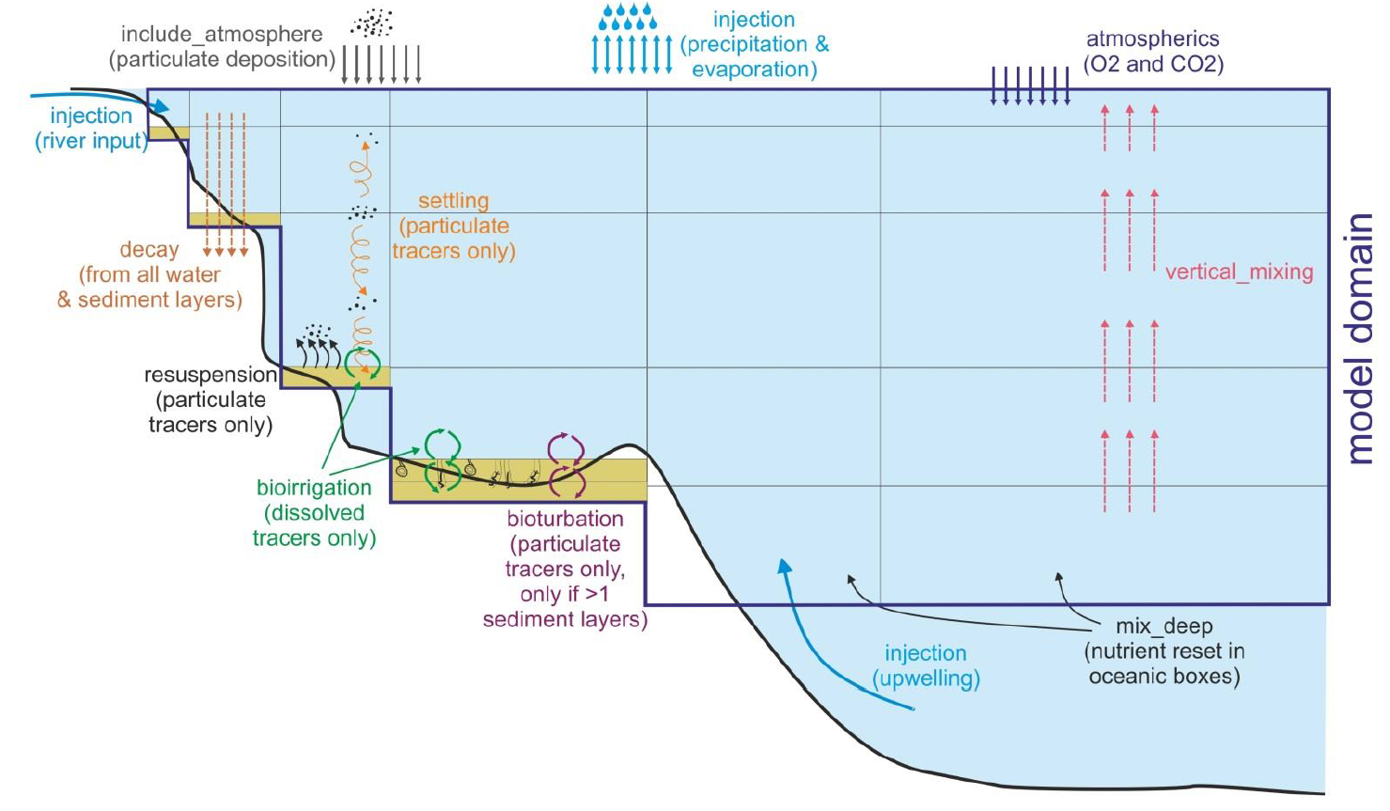
The physics model
Audzijonyte et al. (2017) Atlantis User’s Guide Part I

Slide 6
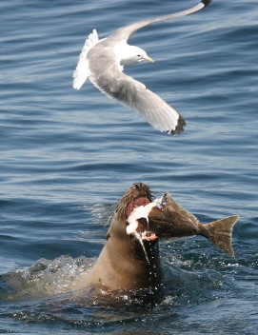
The biology model
Functional groups
Consumption
Predation
Growth
Reproduction
Mortality
Waste production
Movement
Migration

Slide 7
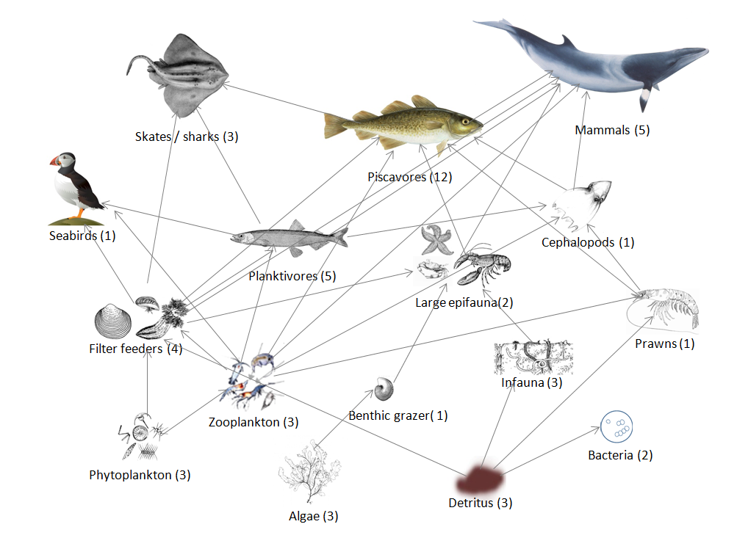
The functional groups
52 functional group
26 vertebrates
17 fish
3 shark/skates
5 mammal
1 seabird
16 invertebrate groups
5 primary producers
2 bacteria
3 detritus

Slide 8
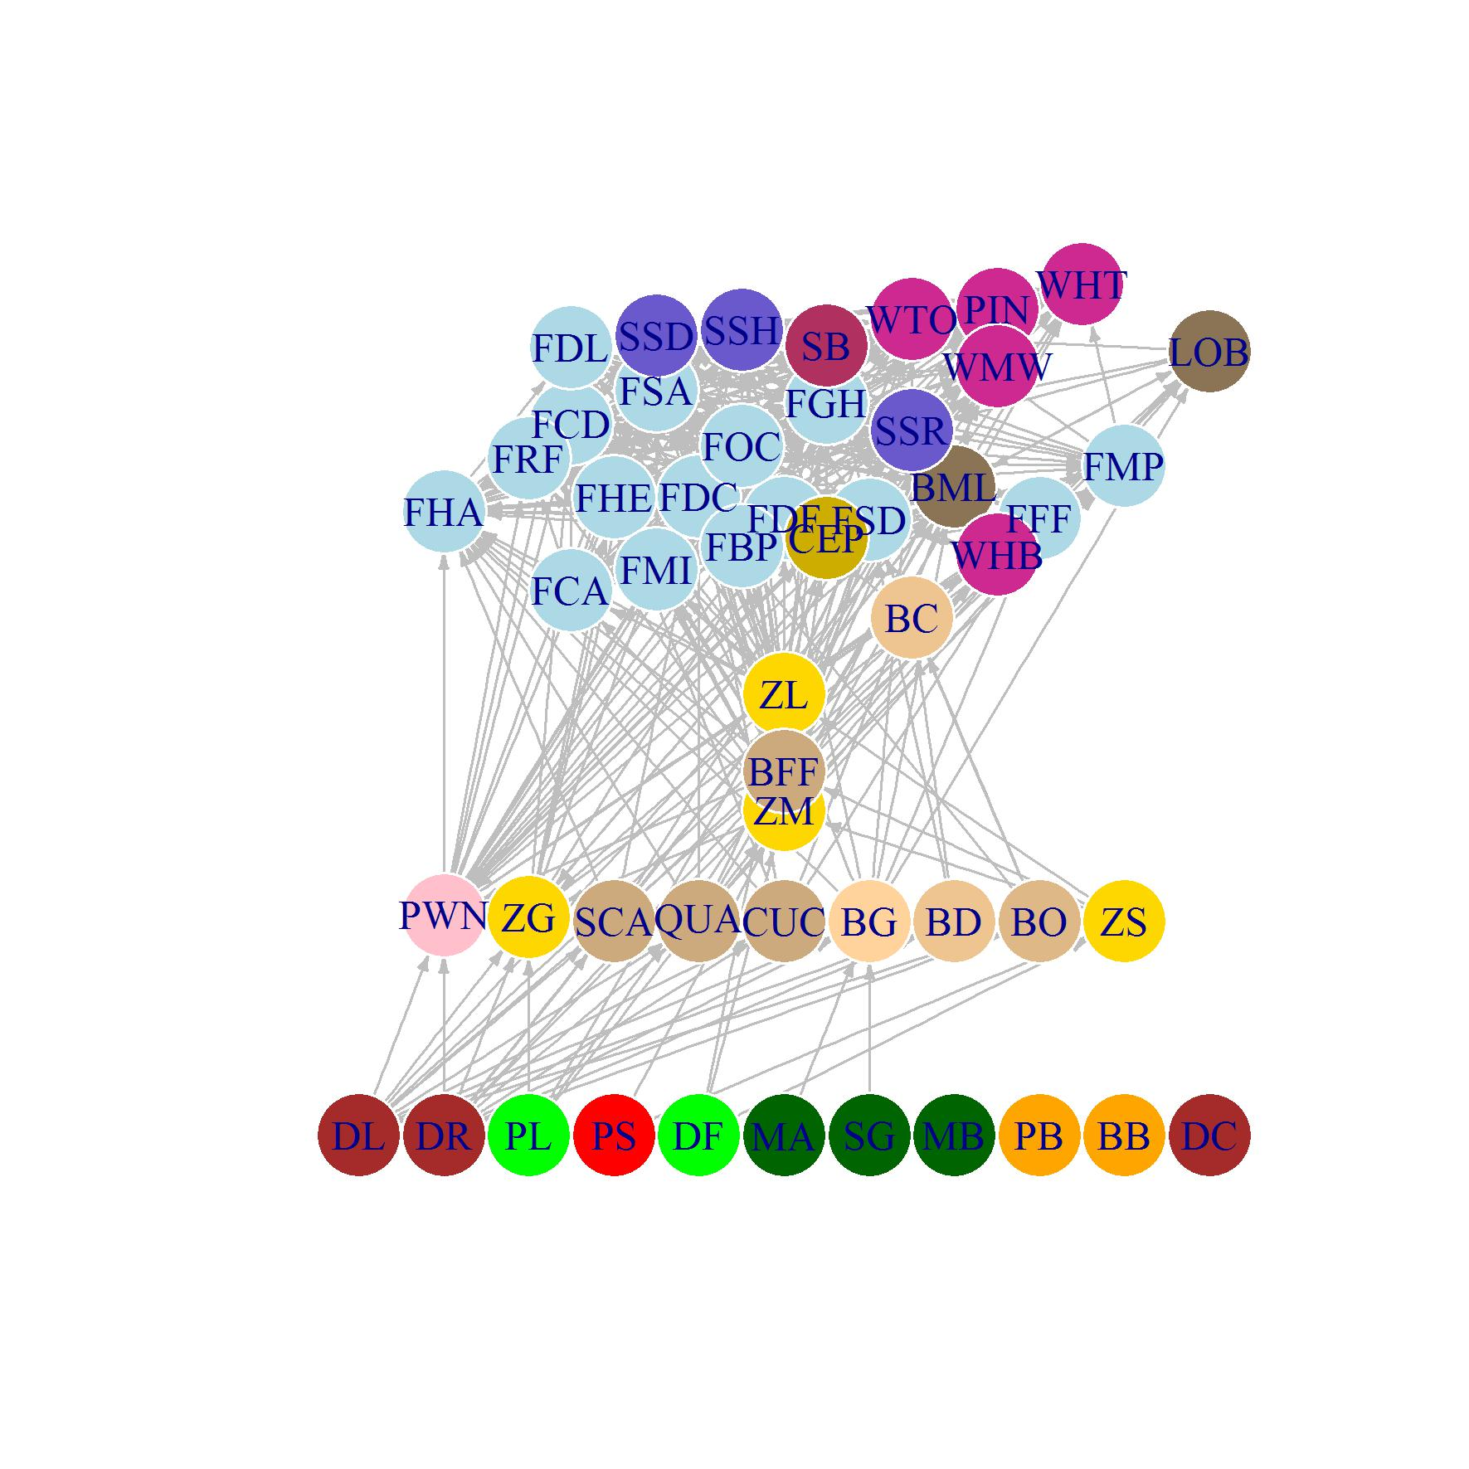
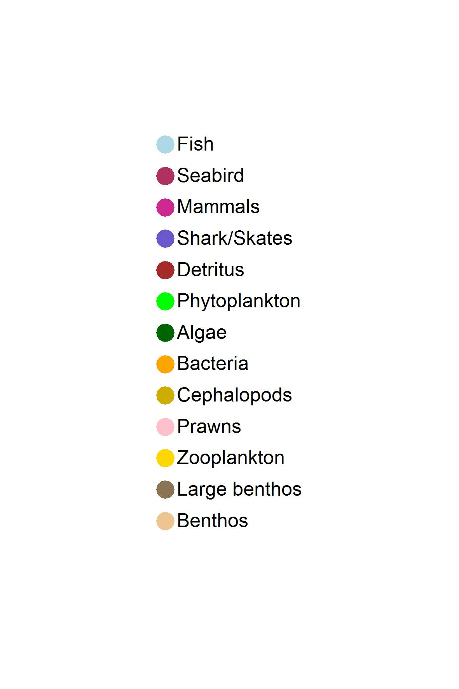
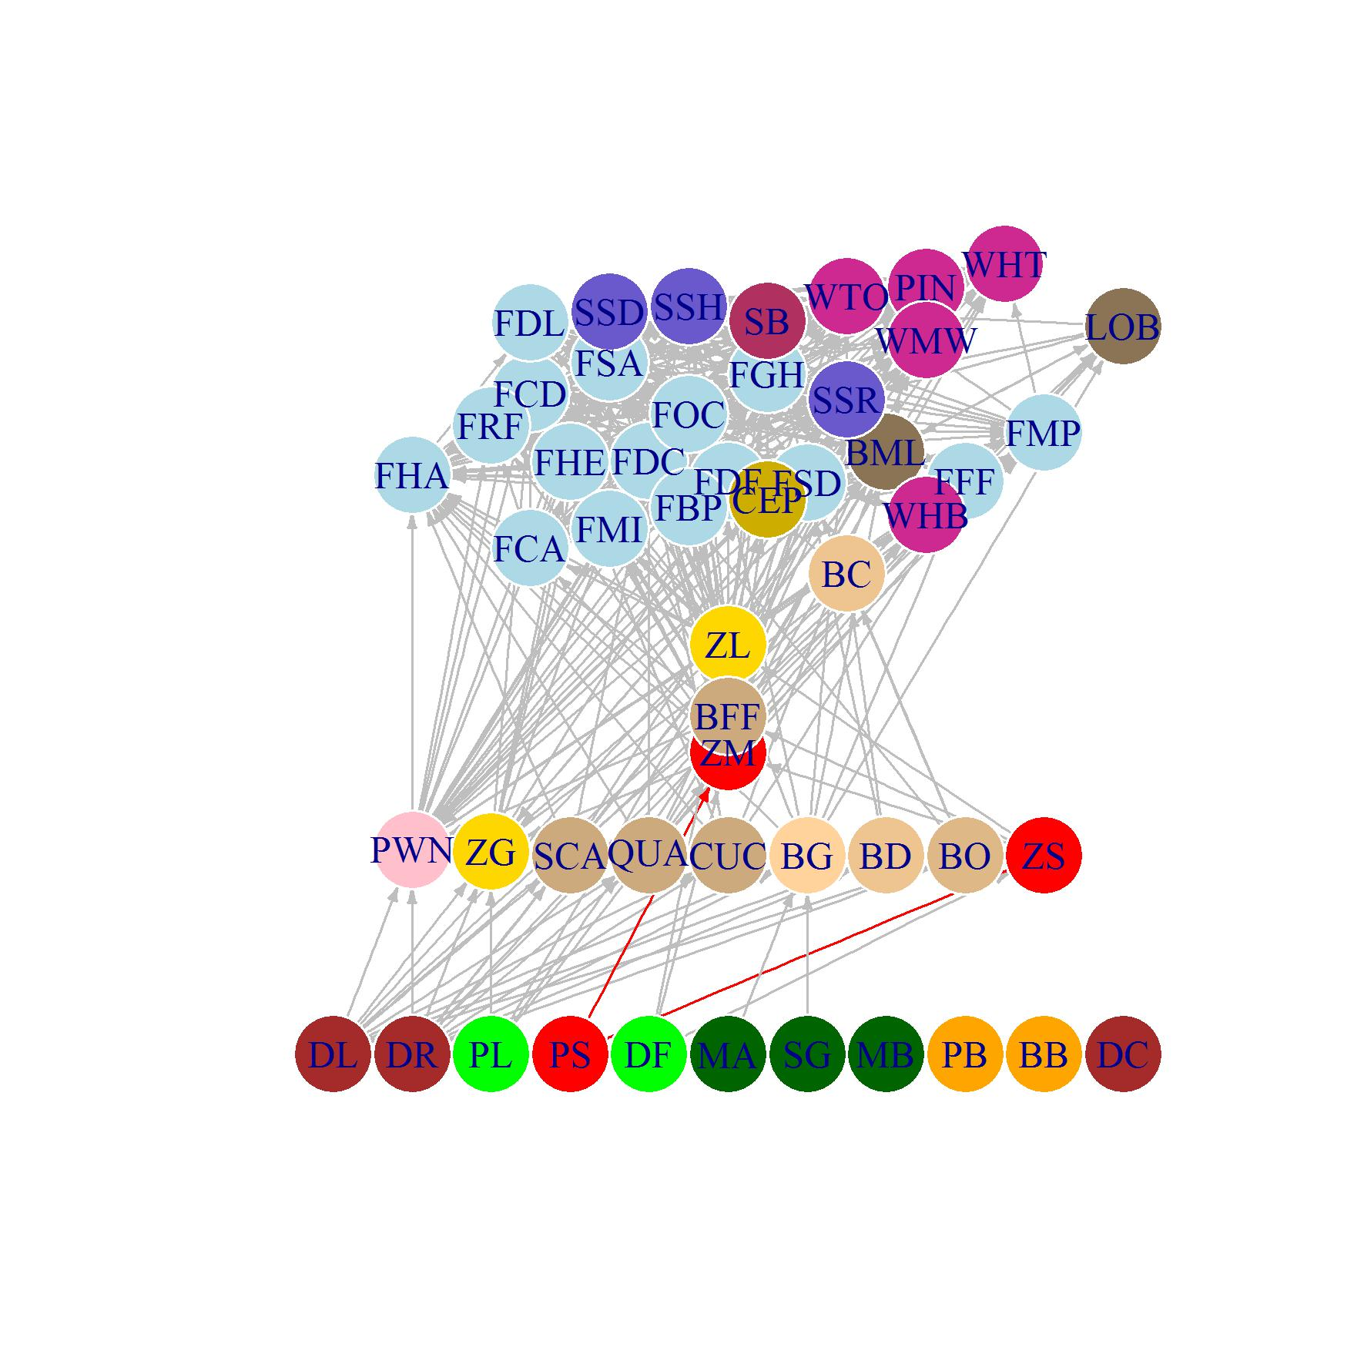
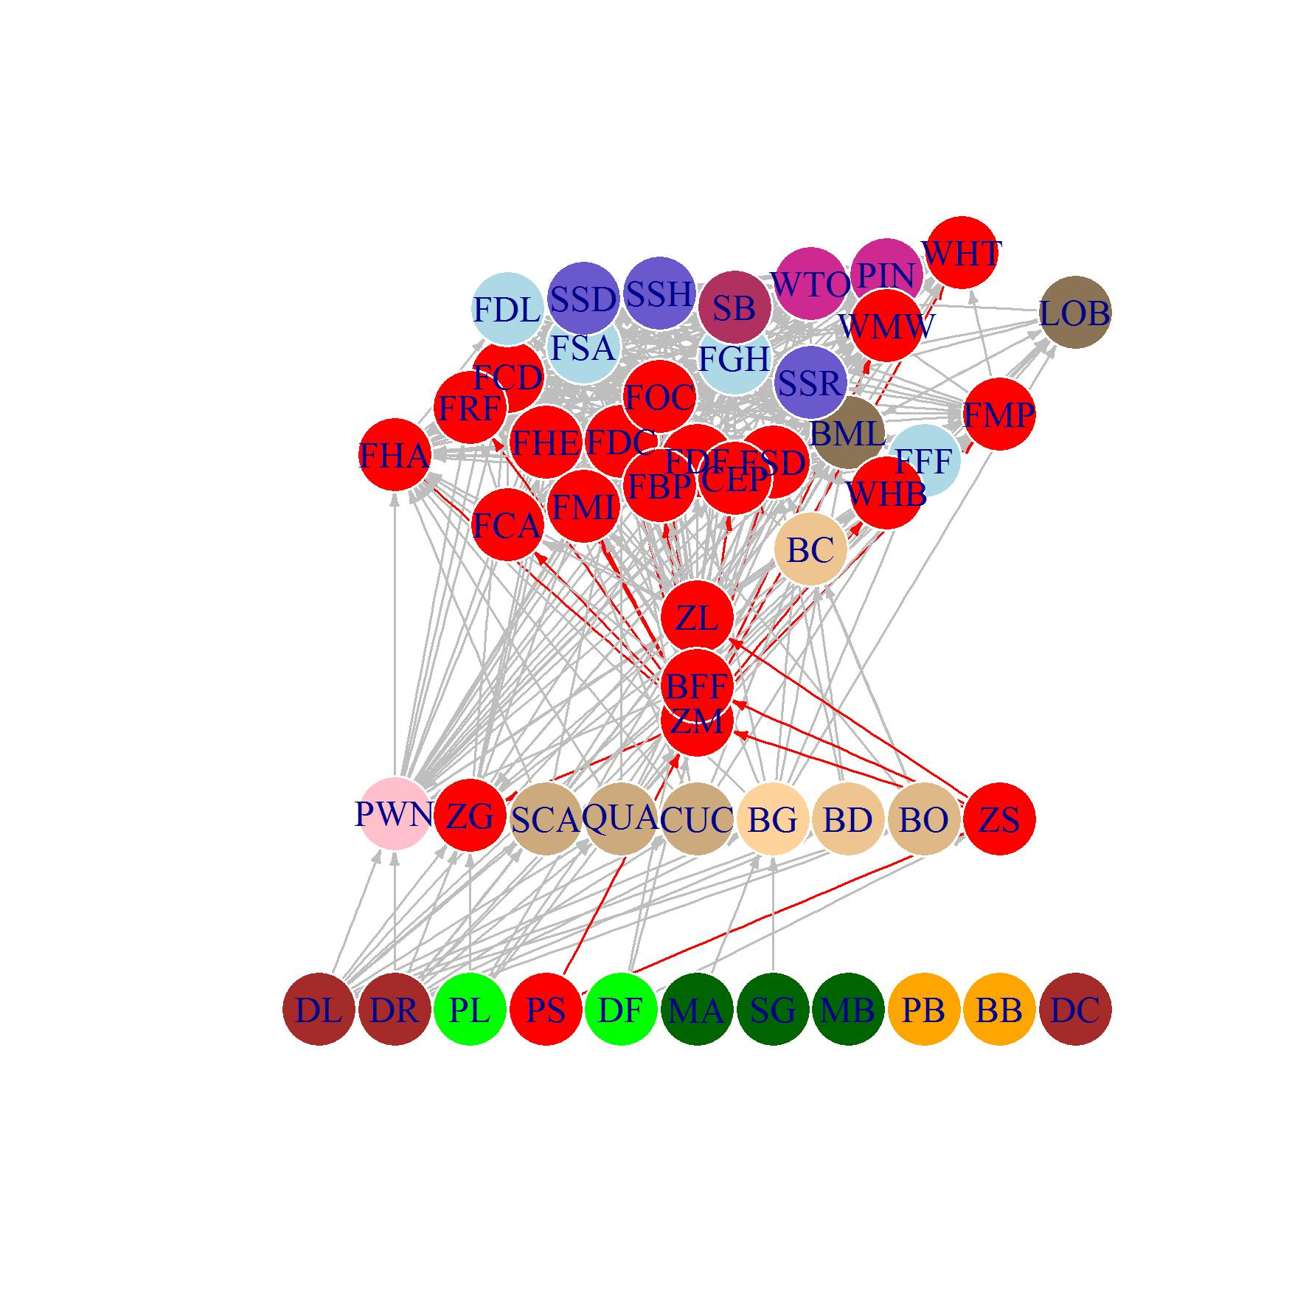
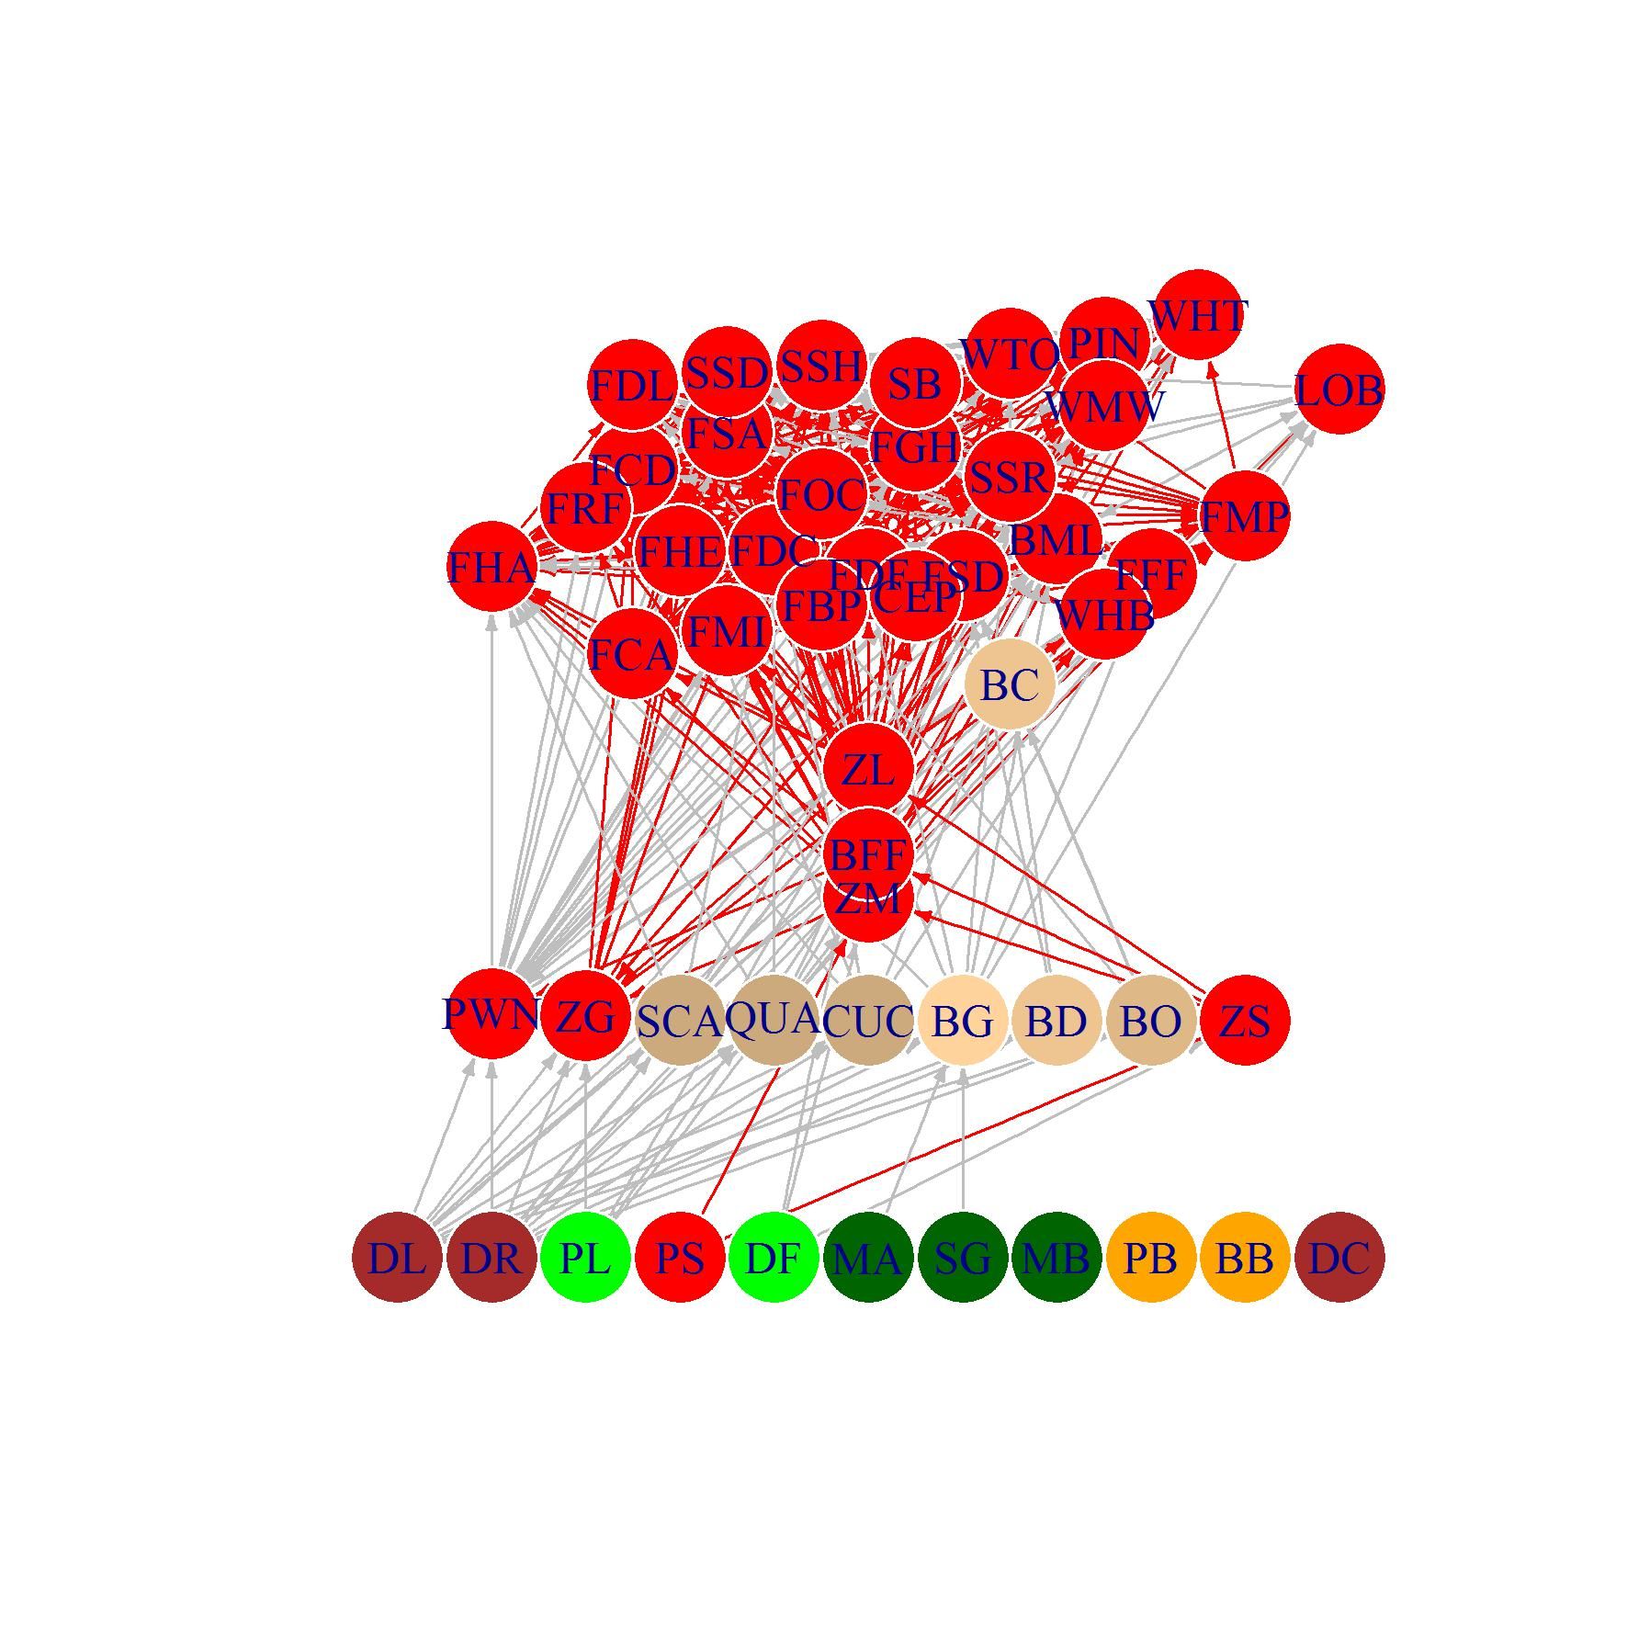
Food web from the Atlantis model

Slide 9
The biology model
Vertebrates
10 age classes
Numbers per age
within ageclass
Weight in mg N per individual
Reserved weight
Structural weight
Invertebrates
2 ageclasses
Biomass pools mg N m⁻³

Slide 10
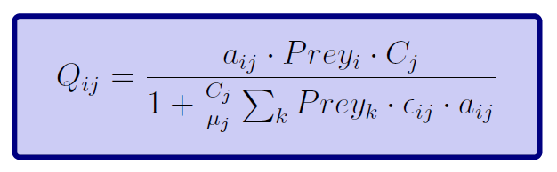
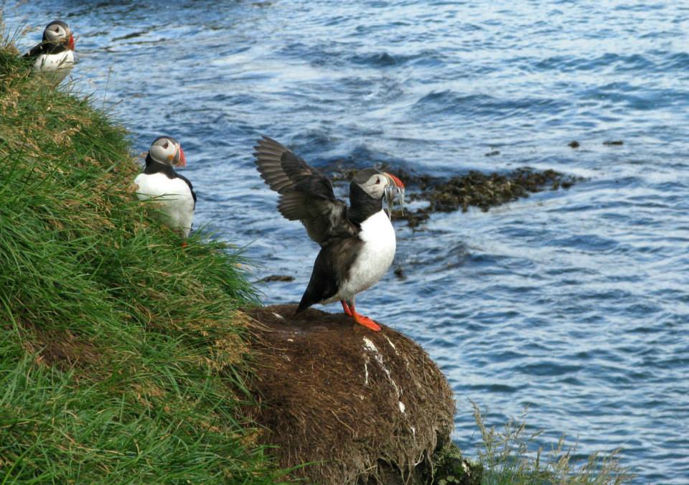
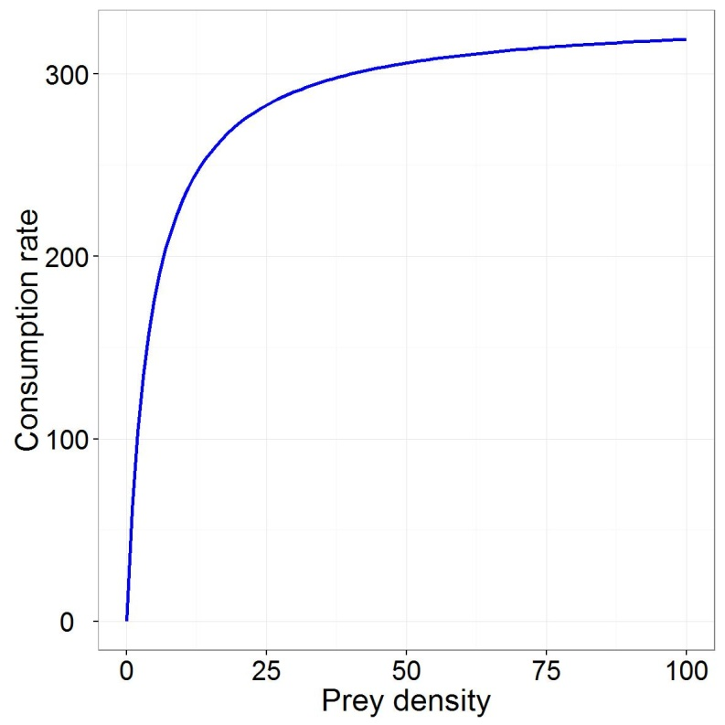
Consumption
Holling type II
Gape limitation
Spatial overlap
Prey availability

Slide 11
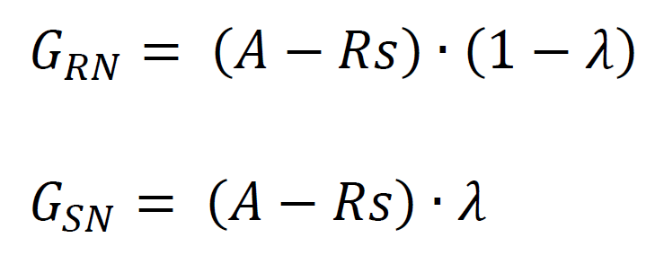
Growth - Vertebrates
Division of growth into reserved and structual weight for invertebrates
A = Consumed * assimilation
Rs = Respiration
λ = division between RN and SN

Slide 12
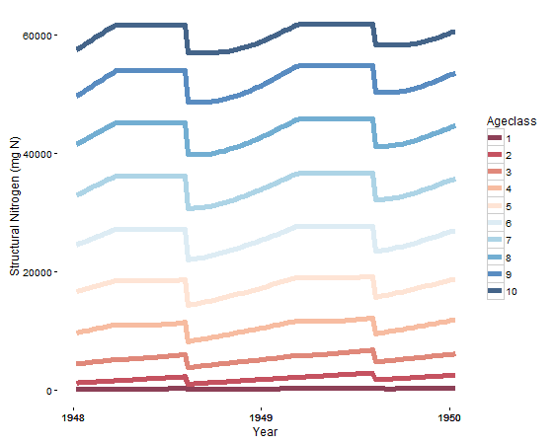
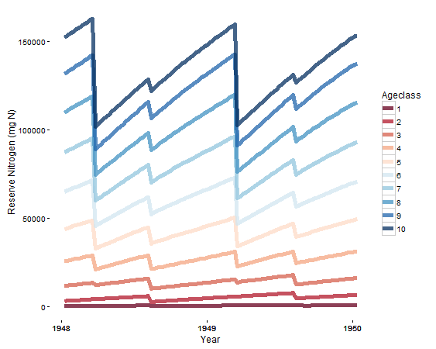
Growth - Vertebrates

Slide 13
Growth – Primary producers
Limited by:
Nutrients
Light
Space
Eddies (optional)
pH (optional)
mum = maximum growth rate

Slide 14
Growth affecting parameters
Consumption
Temperature
Salinity
Assimilation
Time-series of scales
Temperature
Salinity
pH
Respiration
Threshold

Slide 15
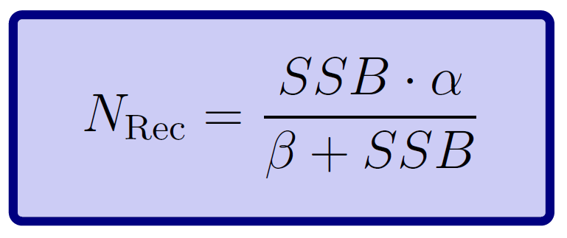
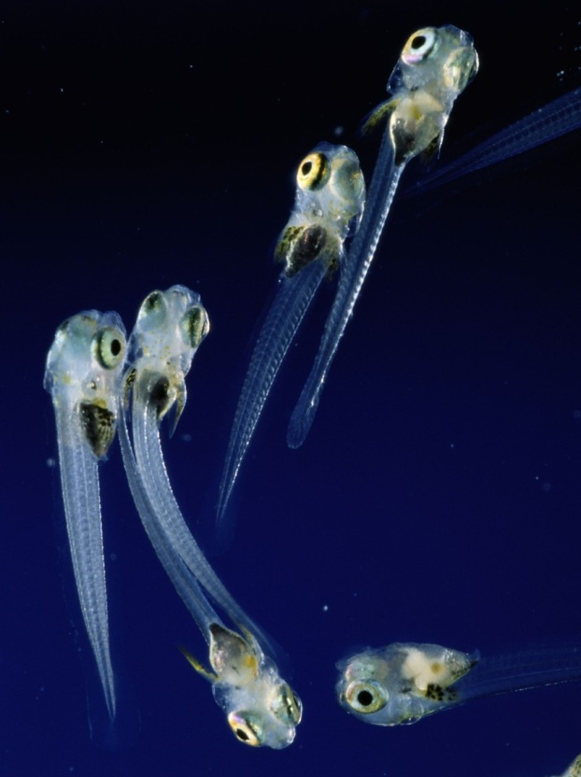
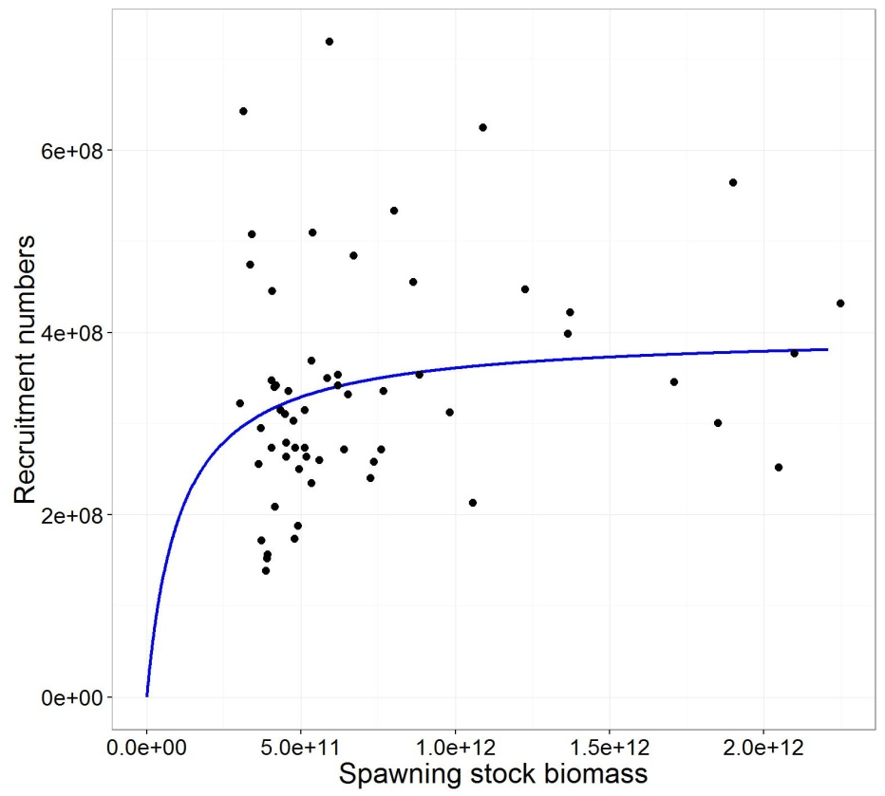
Reproduction
Fixed number per adult
Beverton – Holt
Time-series

Slide 16
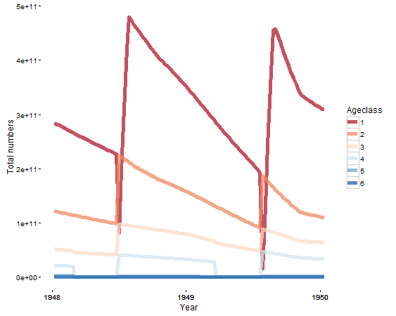
Mortality
Linear mortality
Quadratic mortality
Starvation mortality
Affected by:
Temperature
Salinity
pH
Oxygen

Slide 17
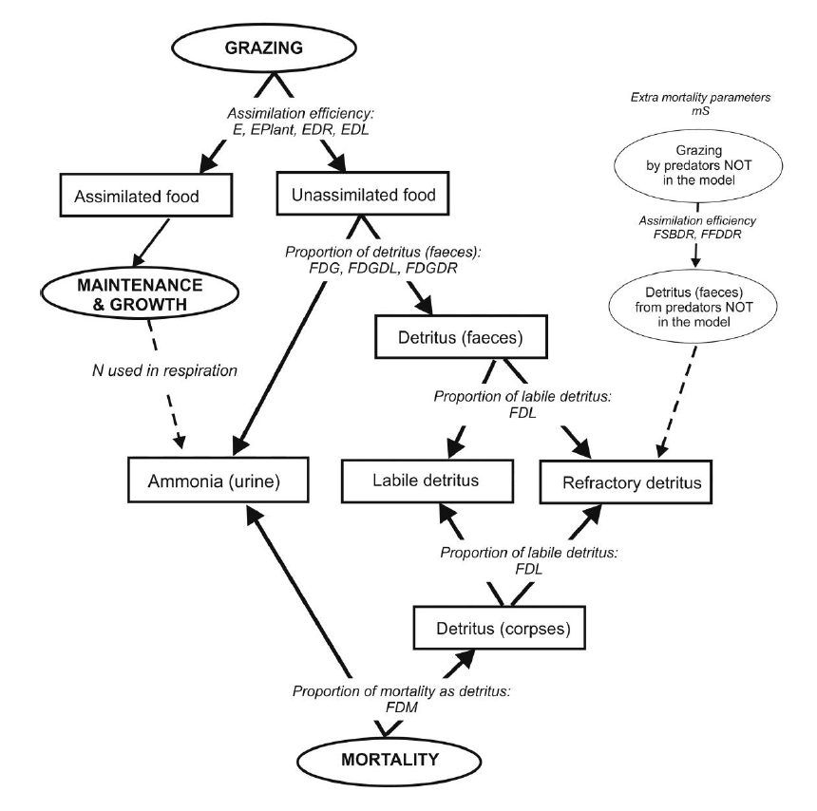
Waste
Audzijonyte et al. (2017) Atlantis User’s Guide Part I

Slide 18
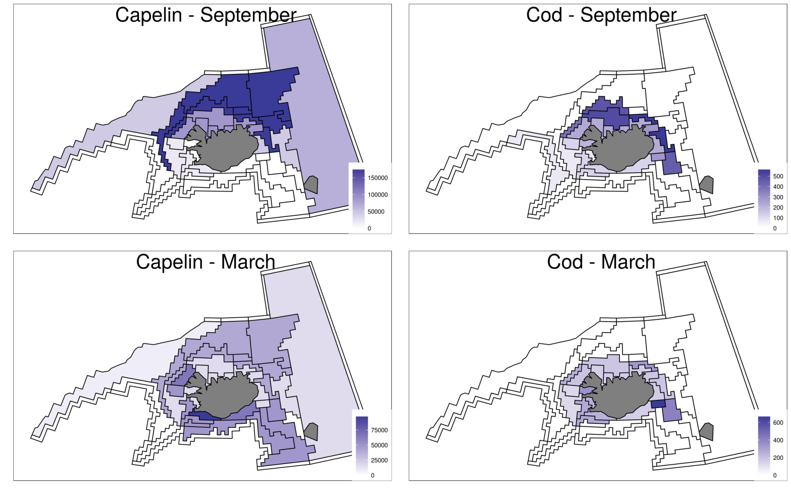
Spatial distribution

Slide 19
Migration and movement
Horizontal movement
Migration within the model
Migration out of the model area
Vertical movement
Night and day

Slide 20
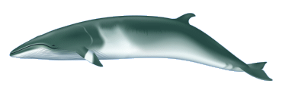
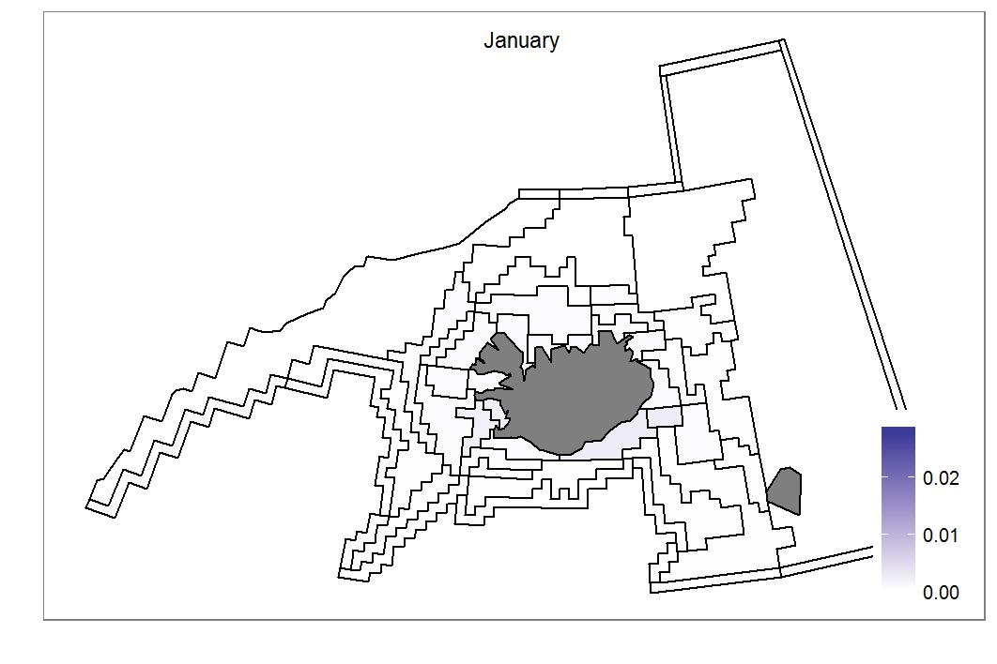


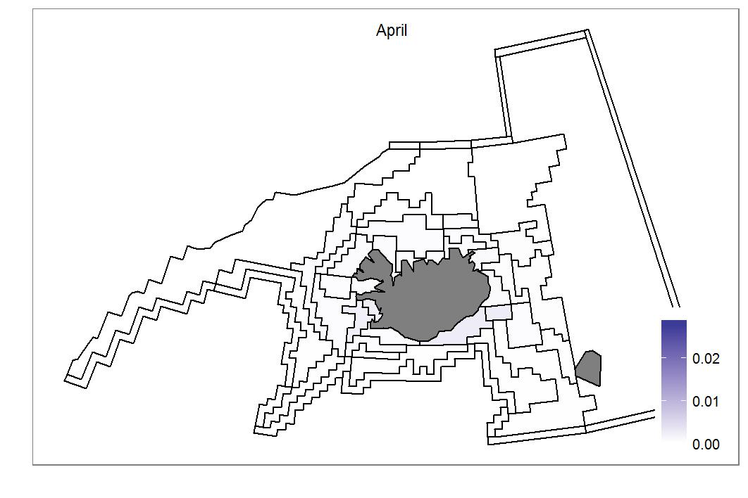
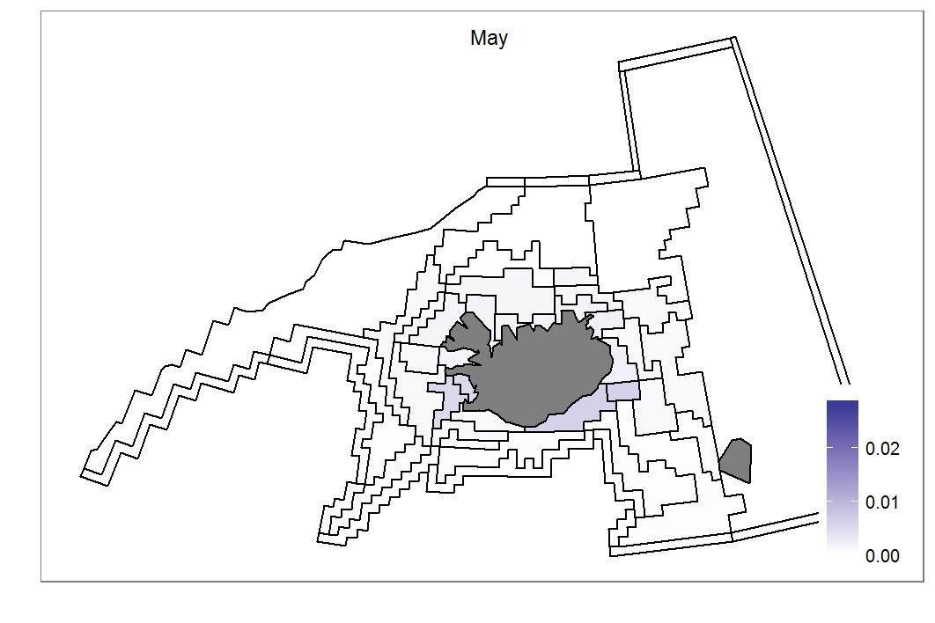
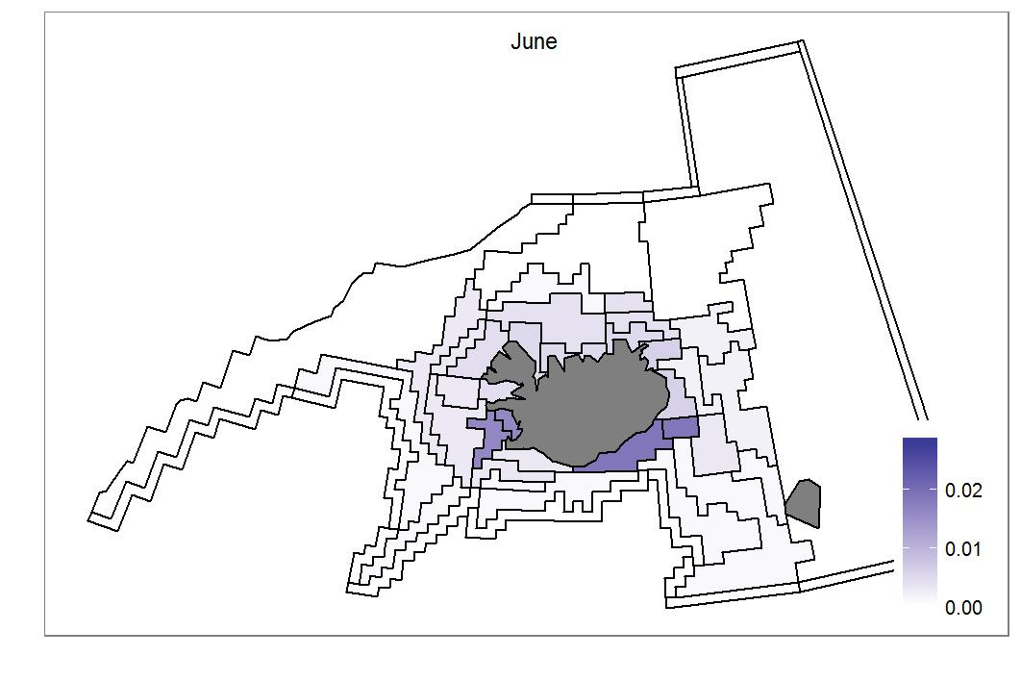
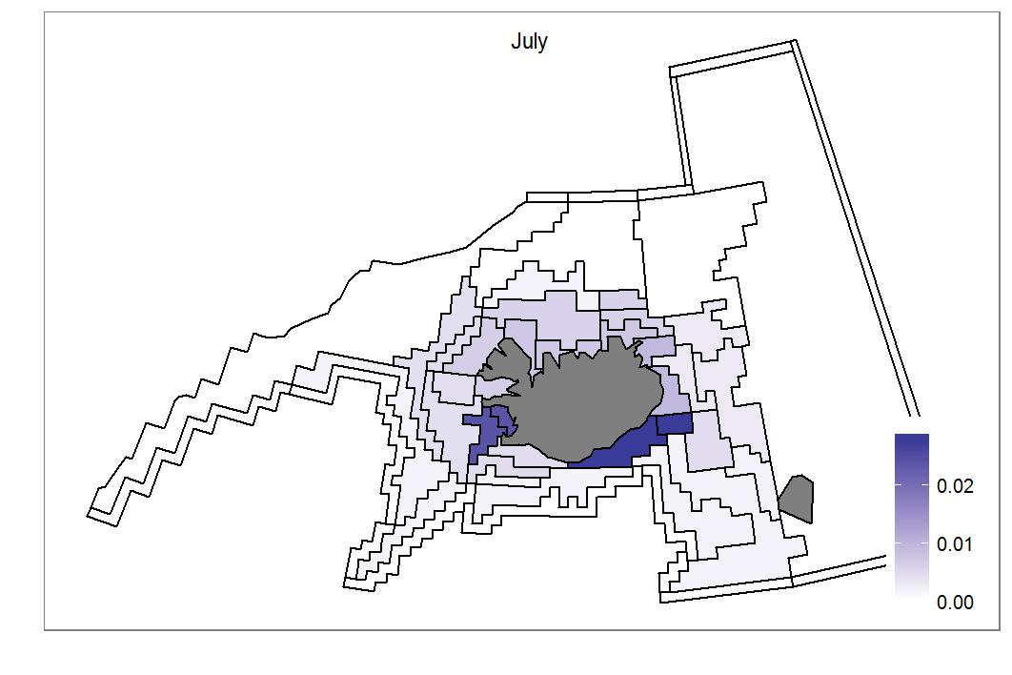

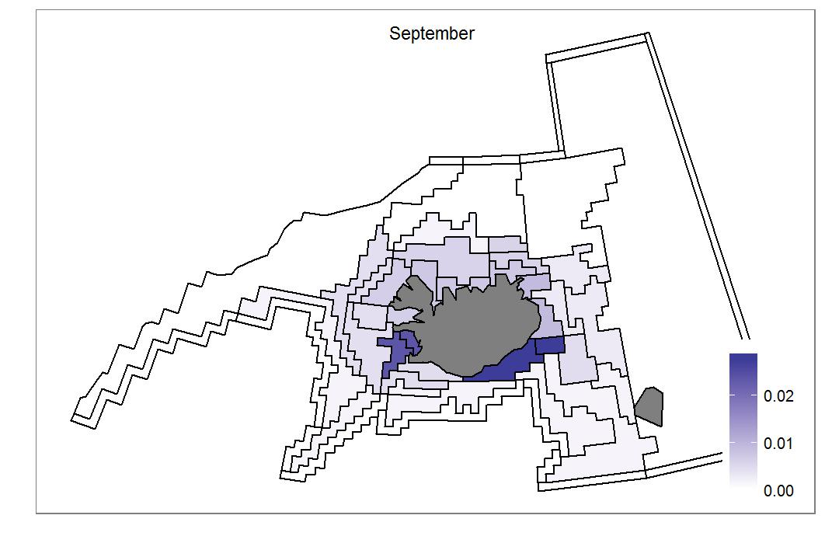
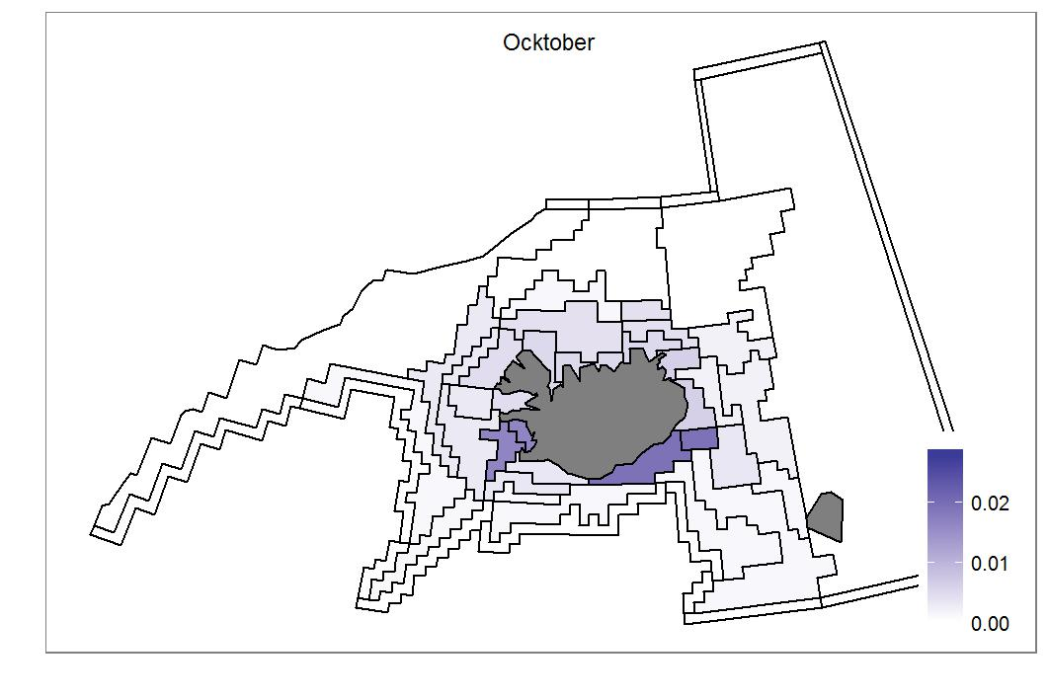
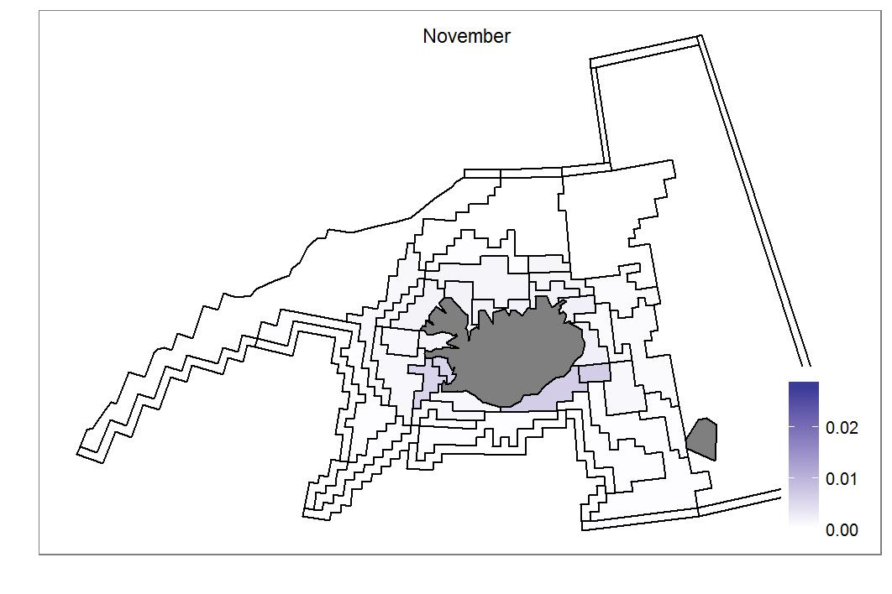

Migration of Minke Whale

Slide 21
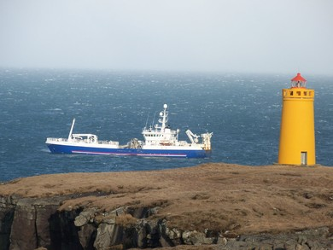
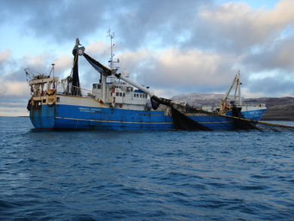
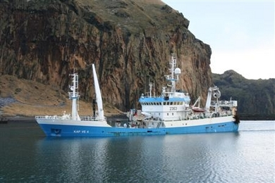
The fisheries model
Fisheries
Multiple fleets
Gear
Target
Selectivity
Photo: Sigurður Bergþórsson
Photo: Magnús Jónsson
Photo Vinnslustöðin

Slide 22
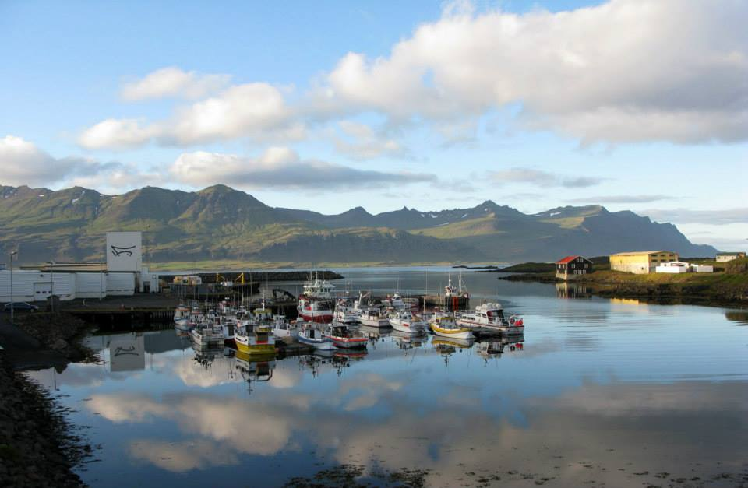
Fishing fleets
Longline
Gillnet
Handline
Purse seine
Danish seine
Midwater trawl
Bottom trawl
Shrimp trawl
Lobster traps
Dredge
Whaling

Slide 23
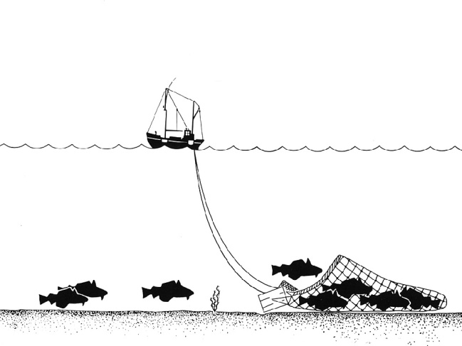
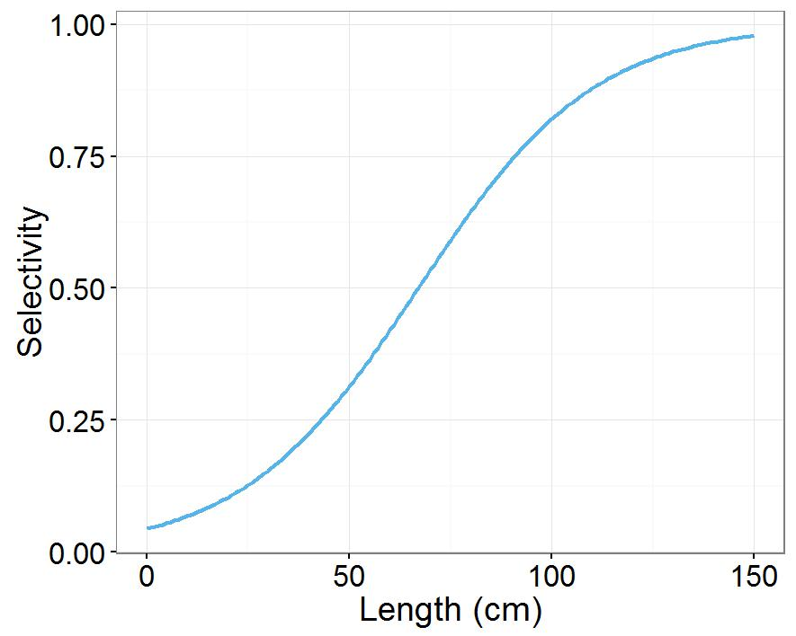
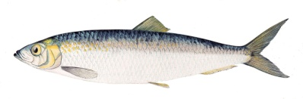
Fishing
Fishing gear
Selectivity
Harvest rate
Catch biomass

Slide 24
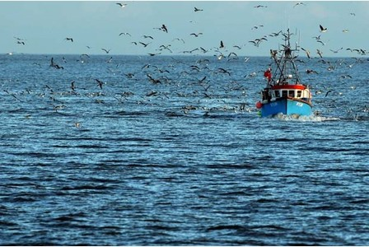
Discards
Constant
Constant per age class
Size based
Discard survival
Discarded waste

Slide 25
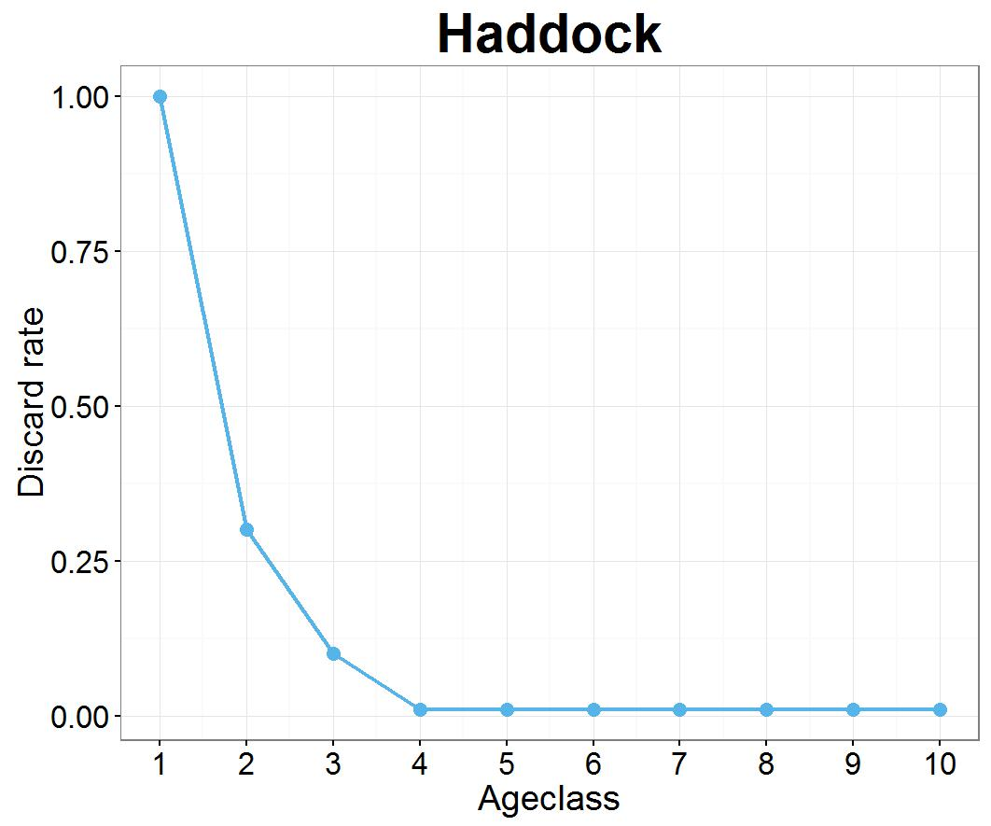
Discards
Constant per age-class

Slide 26
Building the model
Survey data from MRI used
Only available for the commercial species
Biomass estimates from single stock assessments
Logbooks
Information about each tow
Parameters estimted outside of the model
Recruitment curve
Growth curve
Length-weight relationship
Selectivity
A lot of tuning and debugging (2-4+ years)!

Slide 27
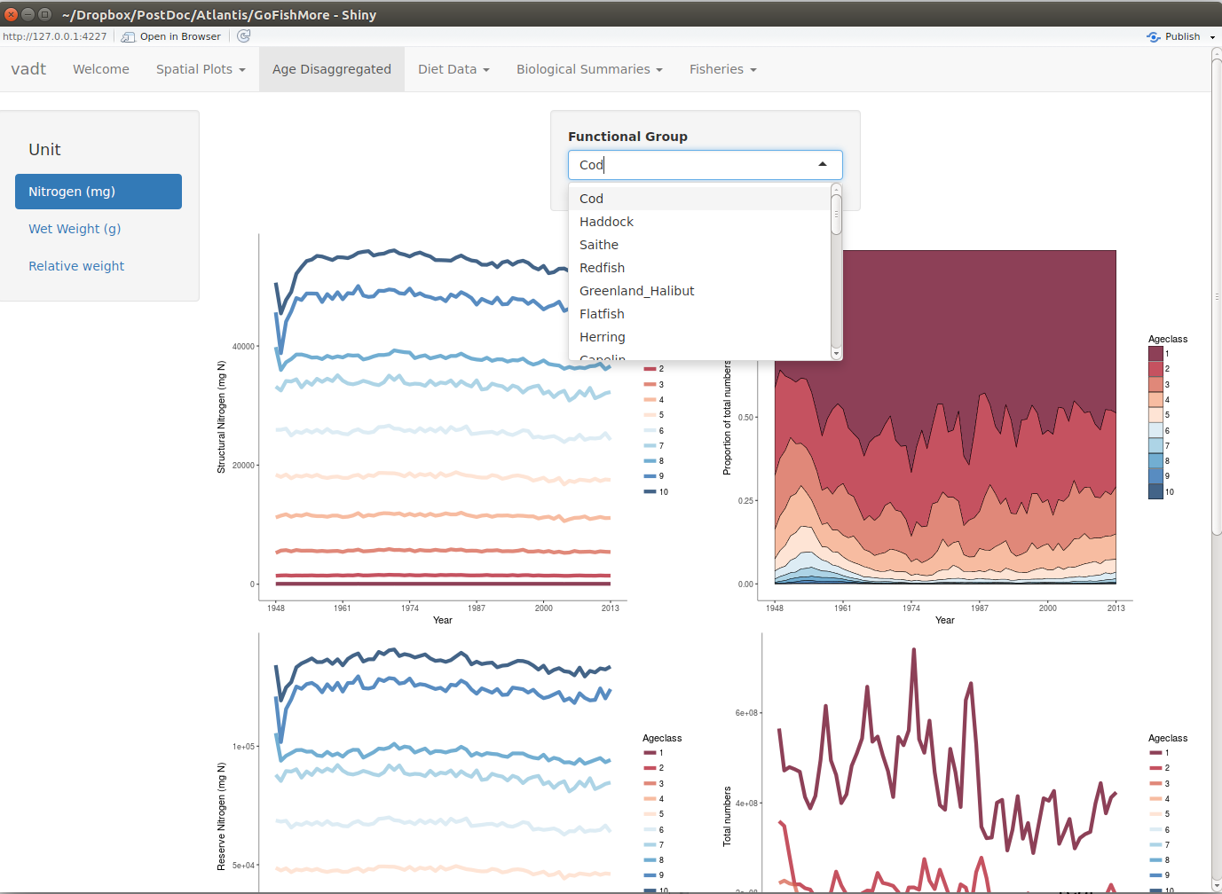
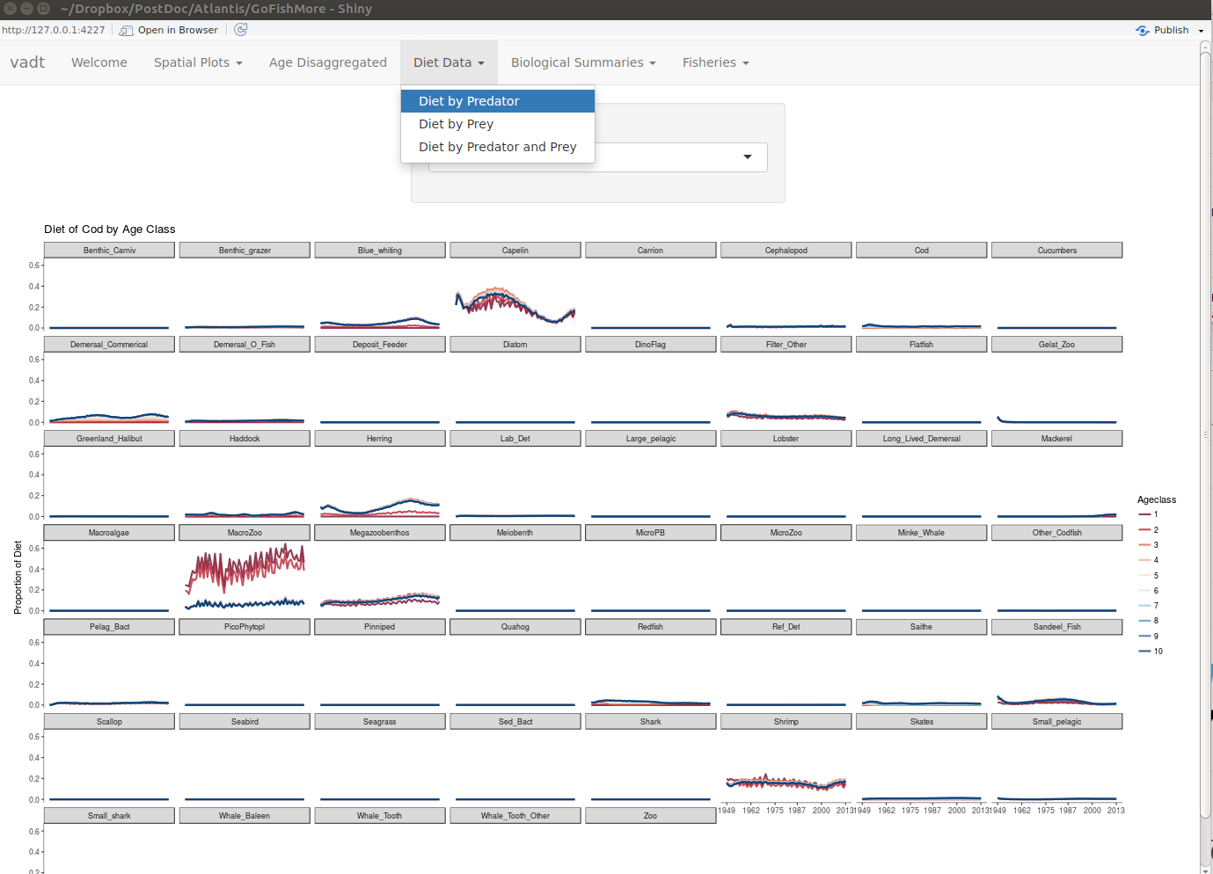
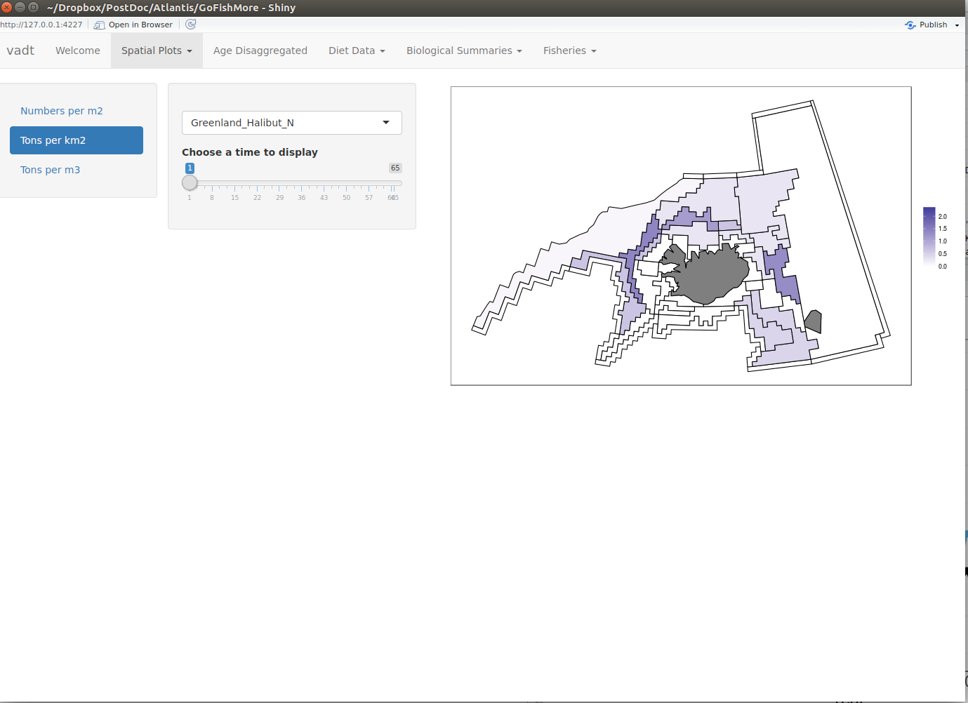
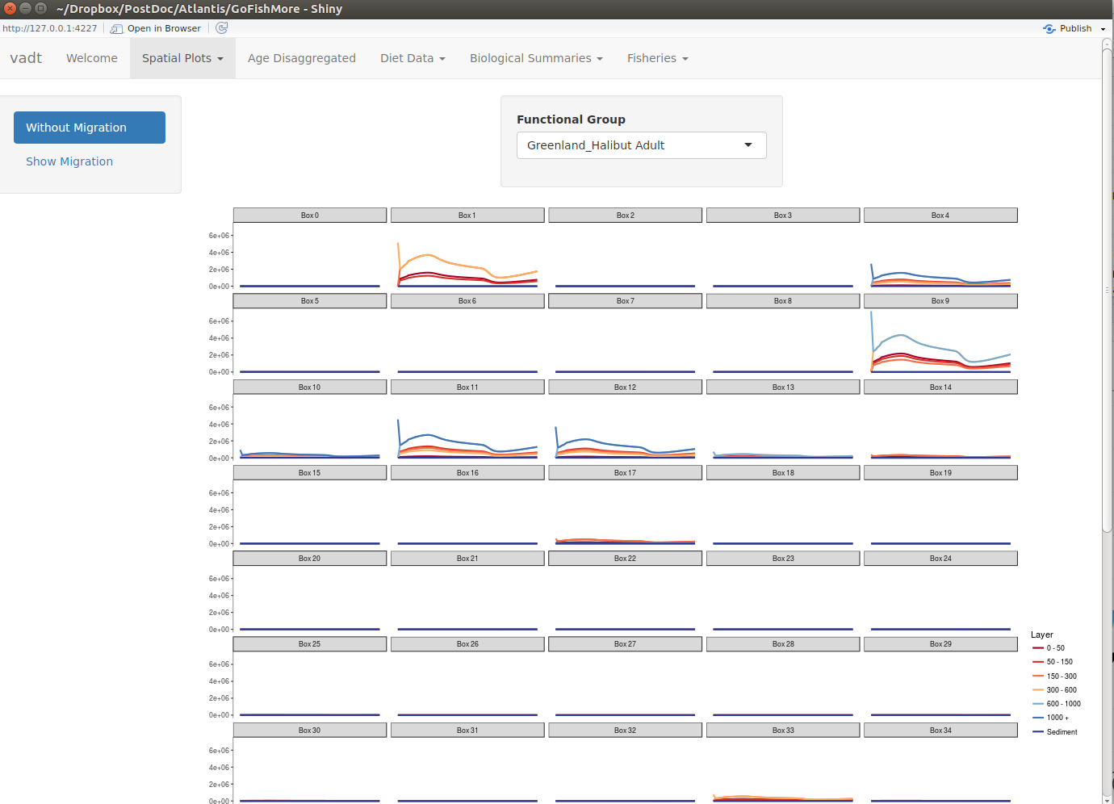
Visualizing the output with Shiny app in R

Slide 28
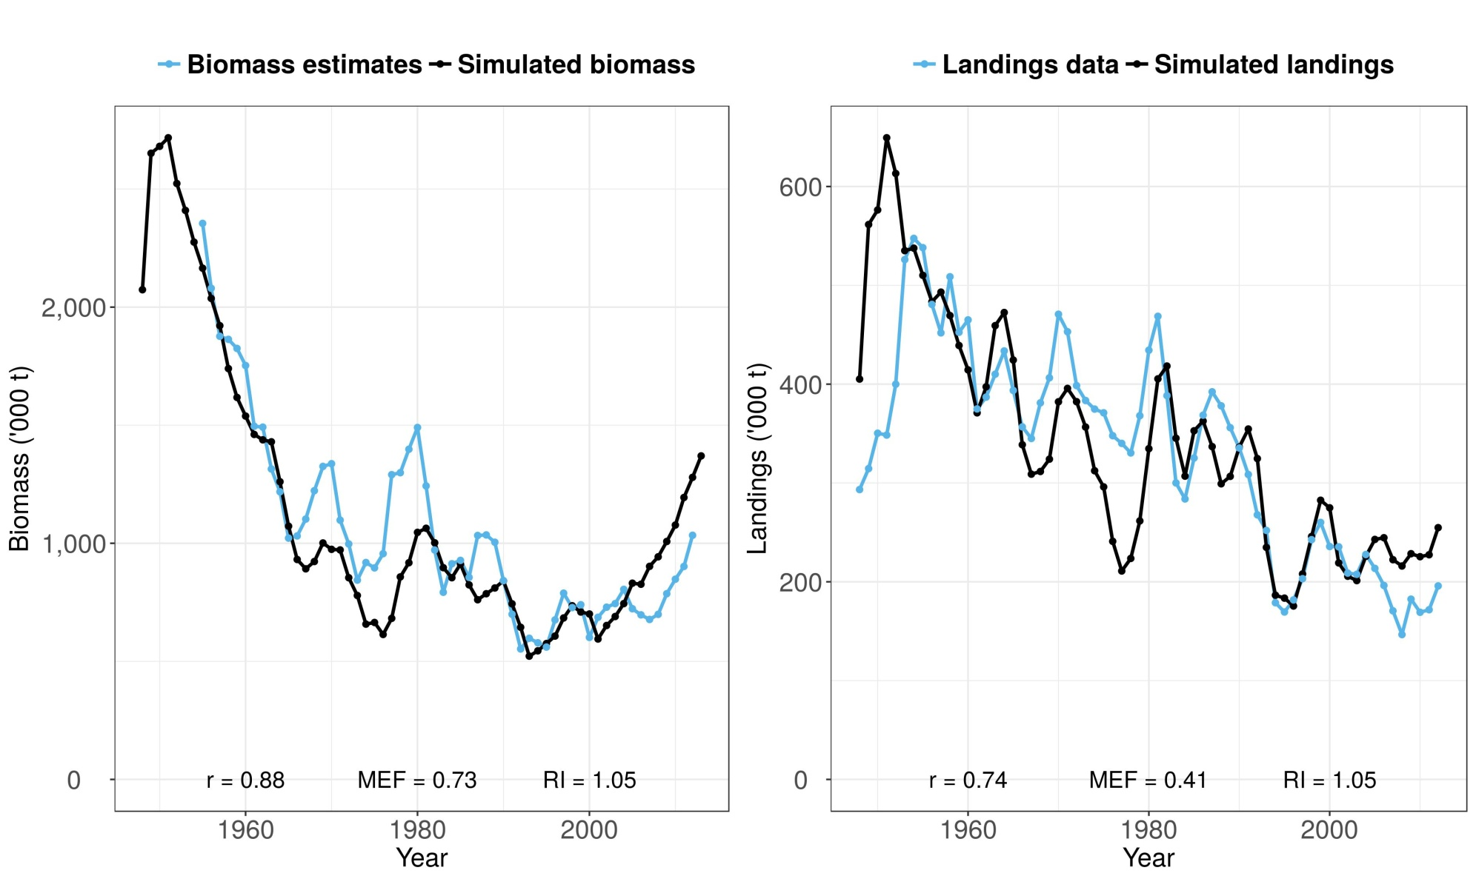
Cod

Slide 29
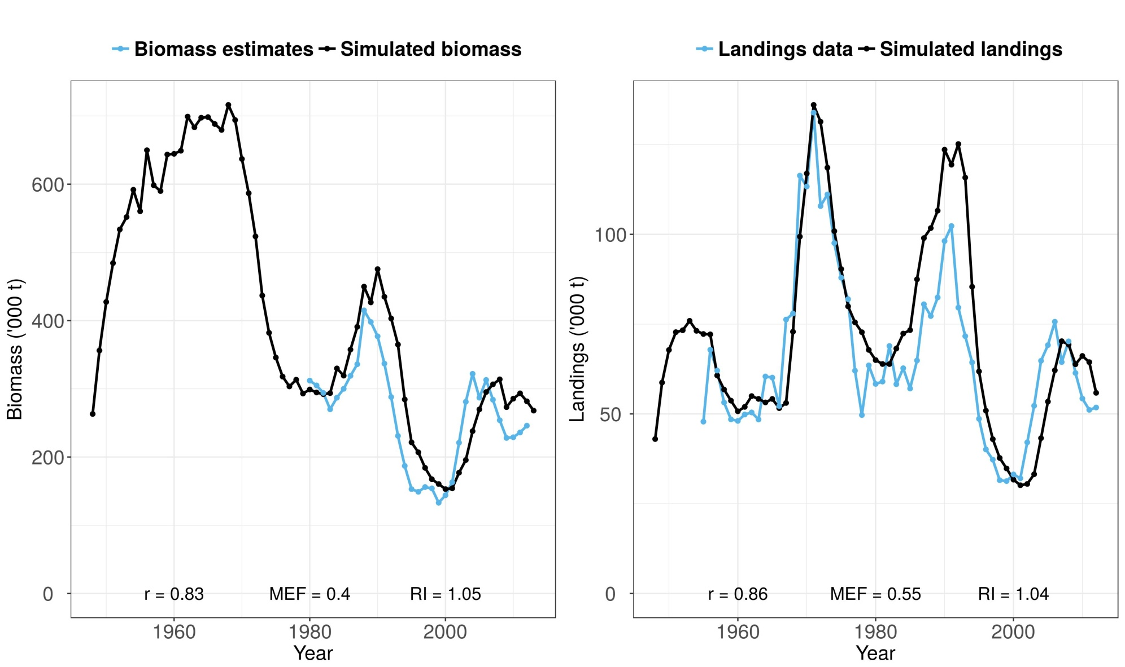
Saithe

Slide 30
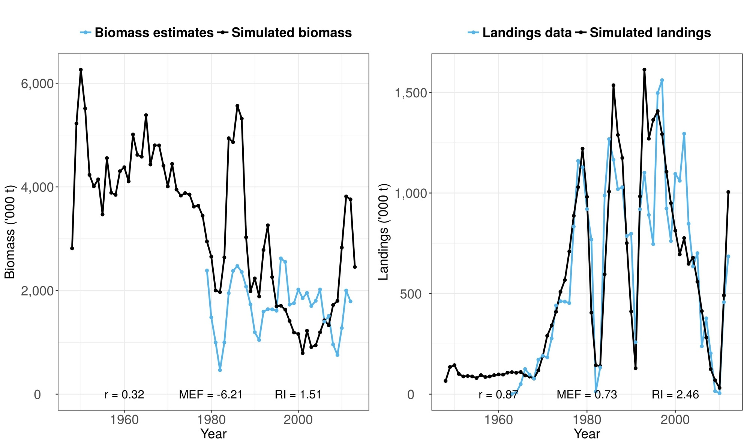
Capelin

Slide 31

Use of Atlantis
Operating model
Scenarios
Fishing pressure
Effect of discards
Management strategy evaluation

Slide 32
Some Atlantis Papers
Sturludottir, E., Desjardins, C., Elvarsson, B., Fulton, E. A., Gorton, R., Logemann, K., Stefansson, G., 2018. End-to-end model of Icelandic waters using the Atlantis framework: Exploring system dynamics and model reliability. Fisheries Research 207, 9-24.
Kaplan, I. C., Holland, D. S., & Fulton, E. A., 2014. Finding the accelerator and brake in an individual quota fishery: linking ecology, economics, and fleet dynamics of US West Coast trawl fisheries. ICES Journal of Marine Science 71(2), 308-319.
Fulton, E. A., Link, J. S., Kaplan, I. C., Savina‐Rolland, M., Johnson, P., Ainsworth, C., Horne, P., Gorton, R., Gamble, R., Smith, A. D. M., Smith, D. C., 2011. Lessons in modelling and management of marine ecosystems: the Atlantis experience. Fish and Fisheries 12(2), 171-188.
Link, J. S., Fulton, E. A., & Gamble, R. J. (2010). The northeast US application of ATLANTIS: a full system model exploring marine ecosystem dynamics in a living marine resource management context. Progress in Oceanography, 87(1), 214-234.

Slide 33


More info
Atlantis User’s Guide
https://www.dropbox.com/sh/1yu72jkzgztfovt/AACKohScfjmsalbwEe7U1BCRa?dl=0
Atlantis Google Group
https://groups.google.com/forum/#!forum/atlantis-ecosystem-model

Slide 34

The official Atlantis Website
http://atlantis.cmar.csiro.au/

